Slide 1
Recurrent Neural Network

Slide 2
Feedforward Network
A trained feed forward network can be exposed to any random collection of inputs, therefore not following any order.
Seeing output of one input cannot help to perceive the next input.
Output at time t is independent of output at time t-1.
But sometimes predicting an output requires its previous output.
Understanding a sentence needs understanding of its previous sentence(s).

Slide 3
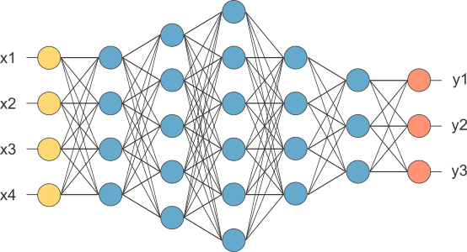
Fully Connected Network
If x_{1 .}... x_{n}, n is very large, parameters of fully connected network would become too large.
We now will input one x_{i} at a time, and re-use the same edge weights.

Slide 4
How do we model sequences?
Bag of Words:
Represent a sequence as bag of words
Bag of word representation does not preserve the orders.
The food was good, not bad at all vs The food was bad, not good at all
Idea: maintain an ordering within feature vector
Hard to deal with different word orders:
on Monday, it was snowing
vs
It was snowing on Monday
We would have to relearn the rules of language at each point in the sentence.

Slide 5
Markov Models
Assumption: Each state depends only on the last state.
Problem: We cannot model long term dependencies.
In France, I had a great time and I learnt –Language
We need information from far past and future to accurately guess the correct word.

Slide 6
RNNs as sequence Modeling
Speech Recognition: Input X is a speech signal transforms to a sentence, i.e. output Y is sequence of words.
Music generation: X may be an empty set, Y is a sequence of tunes of music.
Sentiment classification: X is the sentences, Y is review of a movie.
Video activity recognition: X is Frame of videos, Y is Interpretation
Name entity recognition: X is a sequence of words as sentence, Y is identification of people

Slide 7
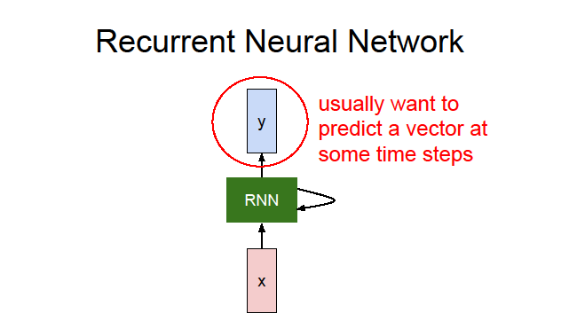
Recurrent Neural Network
Humans don’t start their thinking from scratch every second because thoughts have persistence.
In a traditional neural network we assume that all inputs (and outputs) are independent of each other.
The idea of RNNs is to make use of sequential information.
RNNs address this issue with loops in them, allowing information to persist.
output input past memory
Supervised learning as label data is to be provided

Slide 8
Why RNN?
RNNs accept input vector x and give you an output vector y.
Crucially this output vector’s contents are influenced not only by the input you just fed in, but also on the entire history of inputs you’ve fed in the past, written as a class.
To maintain word order
To share parameters across the sequence
To keep track of long term dependencies
Basic feedforward networks “remember” things too, but they remember the things they learnt during training. While RNNs learn similarly while training, in addition, they remember things learnt from prior input(s) while generating output(s).

Slide 9
RNN as Memory
RNNs are called recurrent because they perform the same task for every element of a sequence, with the output being depended on the previous computations.
RNNs have a “memory” which captures information about what has been calculated so far.
a_{t} = f_{W} (x_{t} , a_{t-1} ) The same function and set of parameters are
cell state function input old state used at every time step
with weight
Apply a recurrence relation at every time step to
process a sequence
y_{t}
RNN
a_{t}
x_{t}

Slide 10
Representing words
As a vocabulary or Dictionary of words of finite size.
One vector representation for each word, i.e. X^{<i>} of dimension say, 10,000
Provide input-output pair, but for each input, output dimension may be different.
One layer in the RNN for each word of a sentence.
There is many more sentences.

Slide 11
Forward Propagation
y^{<T}_{y}>
y^{<t>}
y^{<1>}
y^{<2>}
w_{ya}
w_{ya}
w_{ya}
w_{ya}
H
I
D
D
E
N
L
A
Y
E
R
w_{aa}
a^{<0>}
a^{<1>}
w_{aa}
w_{aa}
w_{aa}
w_{ax}
w_{ax}
w_{ax}
w_{ax}
x^{<1>}
x^{<T}_{x}>
x^{<2>}
x^{<t>}
Activation value passes on next layer a^{<1>}
The parameters at each time step are shared

Slide 12
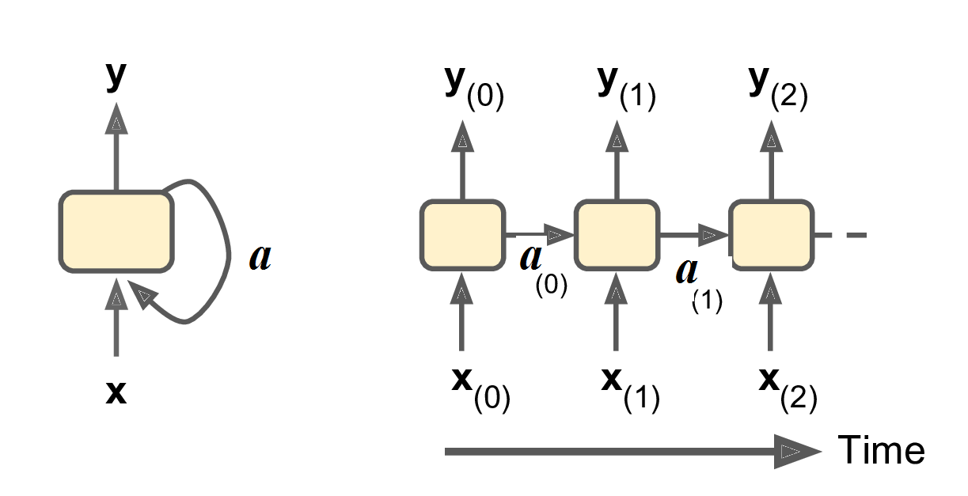
The output of a recurrent neuron at time step t is a function of all the inputs from previous time steps, you could say it has a form of memory. A part of a neural network that preserves some state across time steps is called a memory cell (or simply a cell). A single recurrent neuron, or a layer of recurrent neurons, is a very basic cell,

Slide 13
Forward Propagation
a^{<0>} = 0, a^{<1>} = f_{w} (w_{aa} a^{<0>} + w_{ax} x^{<1>}): tanh/ReLU
y^{<1>} = h (w_{ya} a^{<1>} ): sigmoid/softmax
a^{<t>} = f_{w} (w_{aa} a^{<t-1>} + w_{ax} x^{<t>})
y^{<t>} = h (w_{ya} a^{<t>} )

Slide 14
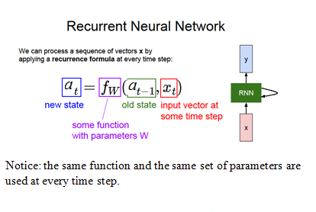

Notice: the same function and the same set of parameters are used at every time step.

Slide 15
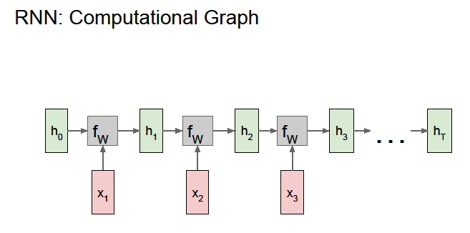
A chunk of neural network, A, looks at some input x_{t} and outputs a value h_{t}
A loop allows information to be passed from one step of the network to the next.
A RNN can be thought of as multiple copies of the same network, each passing a message to a successor.
This chain-like nature reveals that RNNs are intimately related to sequences and lists and the natural architecture of neural network to use for such data.

Slide 16
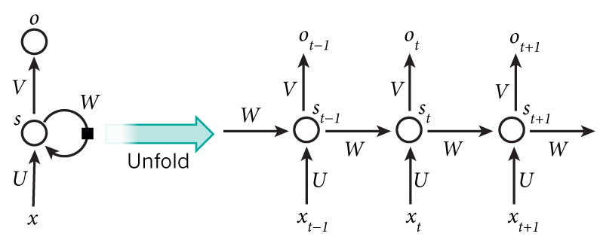
The network for the complete sequence
A recurrent neural network and the unfolding in time of the computation involved in its forward computation.
If the sequence we care about is a sentence of 5 words, the network would be unrolled into a 5-layer neural network, one layer for each word.

Slide 17
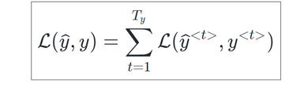
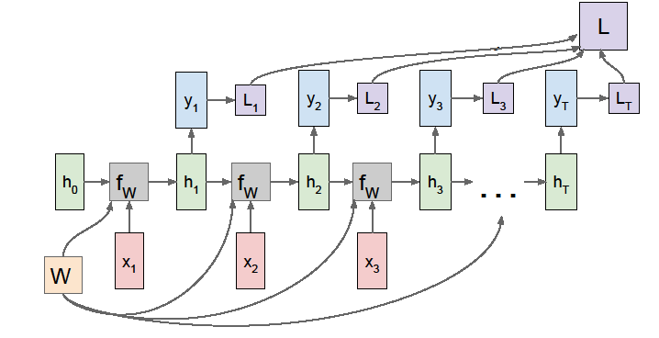
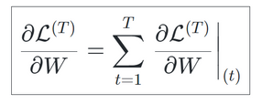
The loss function
The backpropagation for the RNN is calculated over each respective time step.
The representation of the losses over each time step with respect to the weights

Slide 18
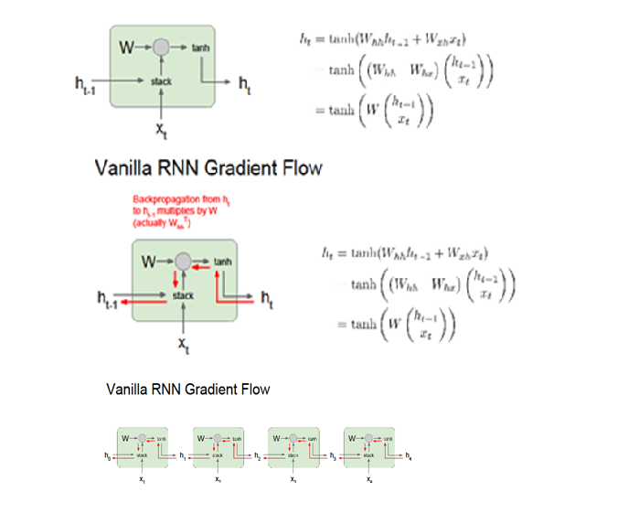
tanh maps all values into a range between -1 and 1, and the derivative
is bounded by 1
● With multiple matrix multiplications, gradient values shrink exponentially
● Gradient contributions from “far away” steps become zero

Slide 19
Training a RNN
RNN uses backpropagation algorithm but it is applied at every time stamp, called backpropagation through time (BTT).
x_{t} is the input at time step t.
h_{t} is the hidden state at time step t. It is the “memory” of the network. h_{t} is calculated based on the previous hidden state and the input at the current step:
h_{t} = f(W_{hx} x_{t} + W_{hh} h_{t-1}).
The function f usually is a nonlinearity such as tanh or ReLU, h_{t -1} required to calculate the first hidden state, typically initialized to all zeroes.
o_{t} is the output at step t. If we want to predict the next word in a sentence it would be a vector of probabilities across our vocabulary: o_{t} = softmax (W_{hy}h_{t})
Issues with Backpropagation: Vanishing Gradient (small change in weight) and Exploding Gradient (large change in weight) due to long term dependency.

Slide 20
Training of RNN
Hidden state h_{t} considered as the memory of the network. h_{t} captures information about what happened in all the previous time steps. The output at step o_{t} is calculated solely based on the memory at time t. In practice can’t capture information from too many time steps ago.
Unlike a traditional deep neural network, which uses different parameters at each layer, a RNN shares the same parameters ( above) across all steps.
This reflects the fact that the same task is performed at each step, just with different inputs reduces the total number of parameters we need to learn.
Outputs may not be available at each time step, but depending on the task this may not be necessary.
For example, when predicting the sentiment of a sentence we may only care about the final output, not the sentiment after each word. Similarly, we may not need inputs at each time step. The main feature of an RNN is its hidden state, which captures some information about a sequence.

Slide 21
Training a RNN
Training a RNN is similar to training a traditional Neural Network.
Because the parameters are shared by all time steps in the network, the gradient at each output depends not only on the calculations of the current time step, but also the previous time steps.
For example, in order to calculate the gradient at t=4 we would need to backpropagate 3 steps and sum up the gradients, so called BPTT.
BPTT have difficulties learning long-term dependencies (e.g. dependencies between steps that are far apart) due to what is called the vanishing/exploding gradient problem.
There exists some machinery to deal with these problems, and certain types of RNNs) were specifically designed to get around them.

Slide 22
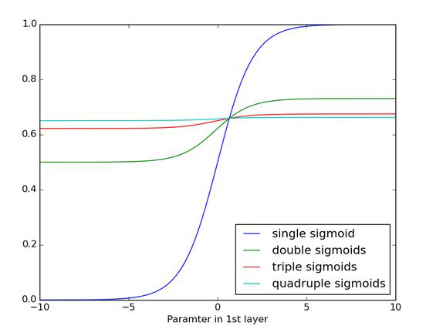
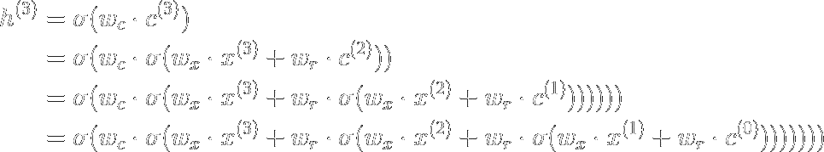
vanishing/exploding gradients during backpropagation

Slide 23
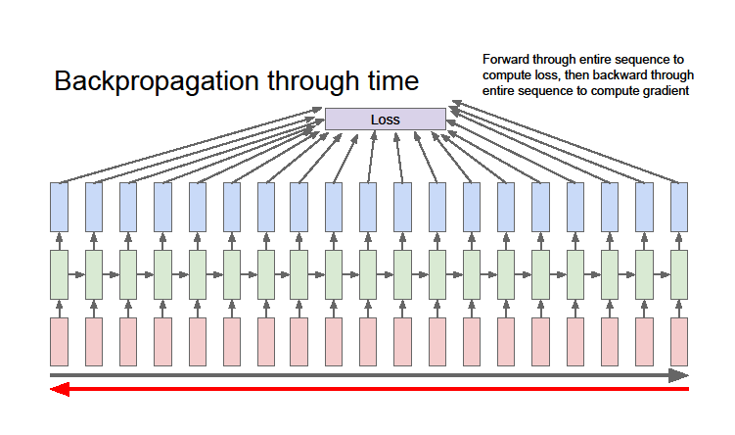
Computational Graph Across Time
Reuse the same weight matrix at every time step

Slide 24
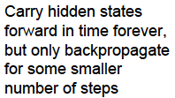
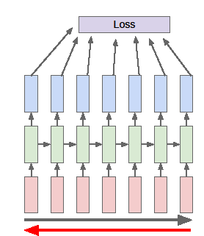

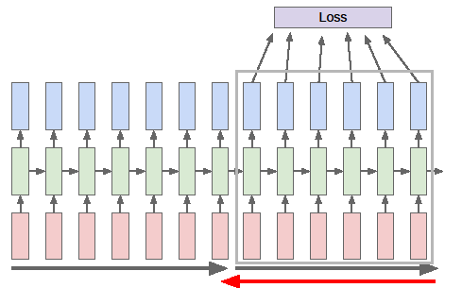
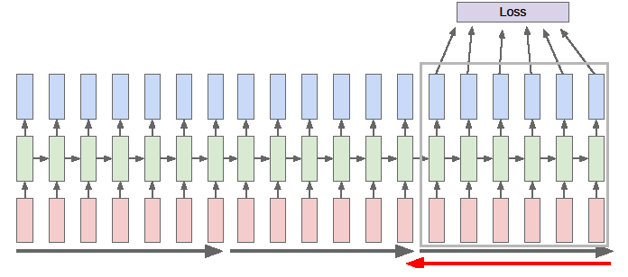

Slide 25
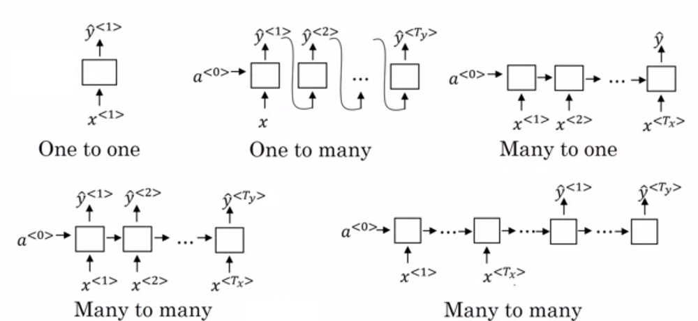
One to one: processing without RNN, from fixed-sized input to fixed-sized output (image classification). One to many: image captioning takes an image and outputs a sentence of words Many to one: sentiment analysis where a given sentence is classified as expressing positive/negative sentiment
Many to many: video classification where each frame of the video is labeled.
Many to one and one to many: Machine Translation, i.e. RNN reads a sentence in English and outputs a sentence in French

Slide 26
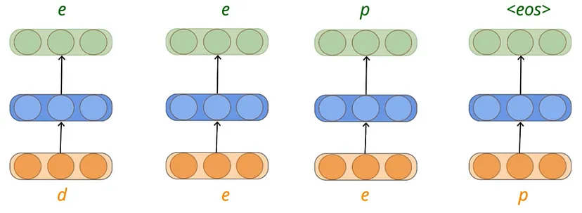
Whenever we type a character (d) the network tries to predict the next possible character from the possible 26 English alphabets given that we have typed ‘d’.
The neural network would have a softmax output of size 26 representing the probability of the next letter given the previous letters.
Since the inputs to this network are characters we need to convert them to a one-hot encoded vector of size 26 and the element corresponding to the index of the alphabet would be set to 1, everything else is set to 0.

Slide 27
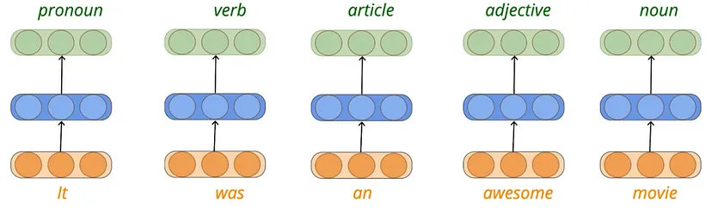
Parts of Speech Tagging
In the problem of parts of speech tagging, we are given a sequence of words for every word we need to predict the part of speech tag for that word (eg: verb, noun, pronoun, etc…).
The output is not only dependent on the current input (current word) but also on the previous input. For example, the probability of tagging the word ‘movie’ as a noun would be higher if we know that the previous word is an adjective.

Slide 28
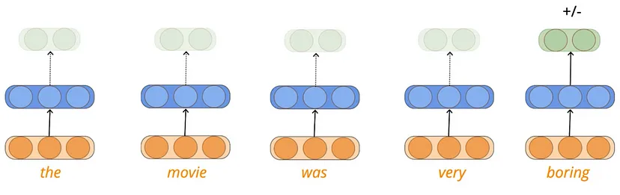
Sequence Classification
Understanding the mood from a text with machine learning is called Sentiment analysis.
In this scenario, we don’t need to output after every word of the input rather we just need to understand the mood after reading the entire sentence

Slide 29
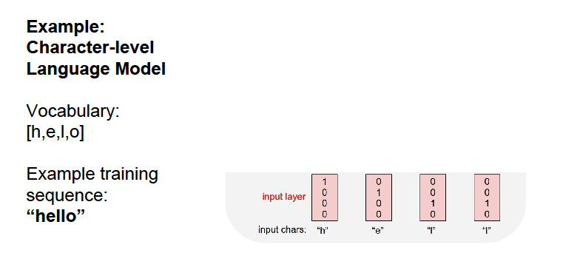
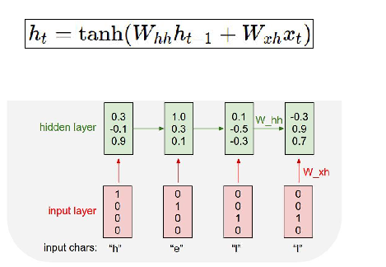
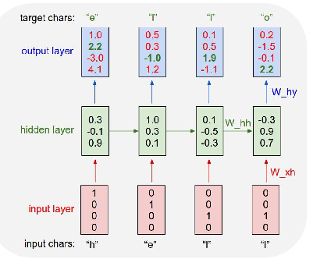

Slide 30
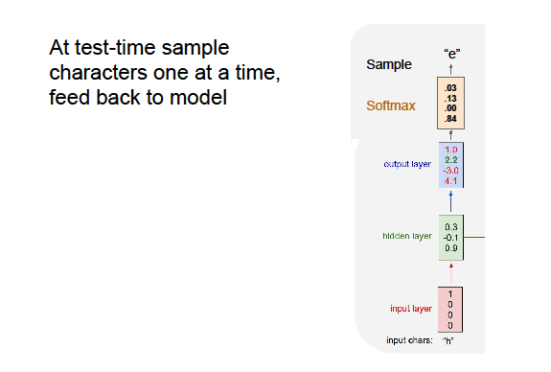
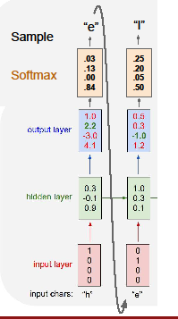
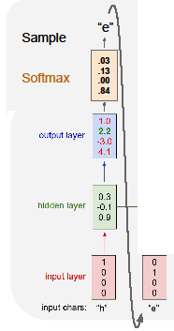
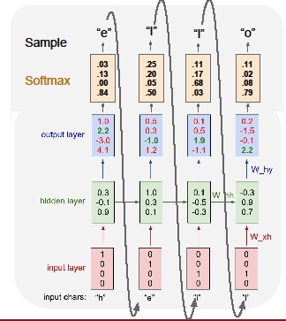

Slide 31
Predict the Next Word
“This morning I took my cat for a walk”
Given words predict the next word
Embedding: Transform Indexes into a vector of fixed size
Vocabulary, (ii) Indexing (word to index), (iii) one hot embedding, say for “cat” [0, 1, 0, 0 ,0, 0]
(iiia) Learned Embedding: (happy, sad); (dog, cat); (run, walk); (sun, day)

Slide 32
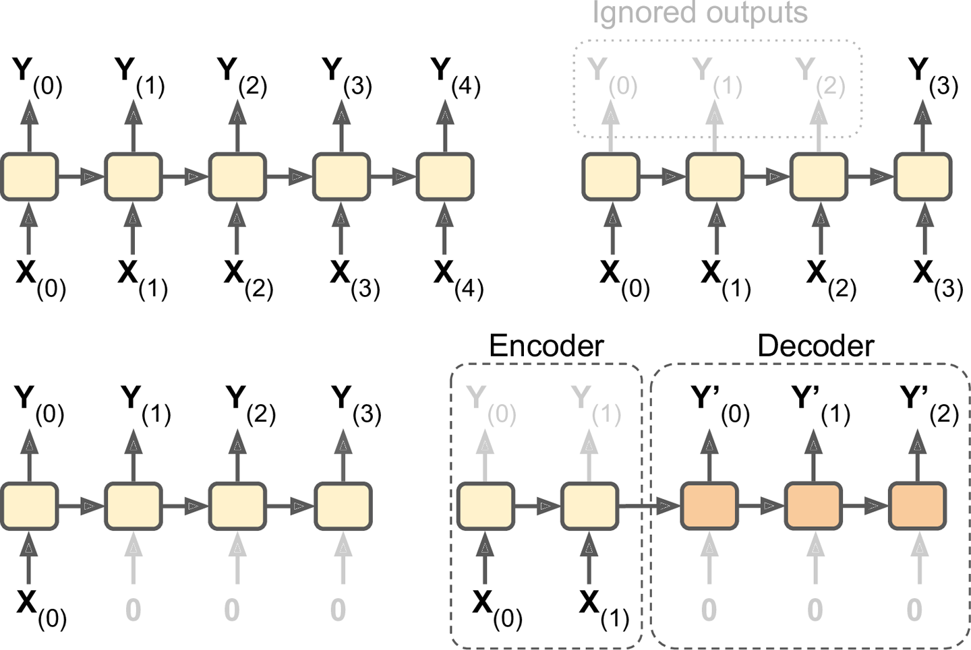
Take a sequence of inputs and produce a sequence of outputs
Feed the network a sequence of inputs, and ignore all outputs except for the last one
vector-to-sequence
network
The input could be an image,
and the output could be a caption for that image.
A sequence-to-vector network, called an encoder, followed by a vector-to-sequence network, called a decoder .

Slide 33
Encoder-Decoder Model
Used for translating a sentence from one language to another.
You would feed the network a sentence in one language, the encoder would convert this sentence into a single vector representation, and then the decoder would decode this vector into a sentence in another language.
Encoder-Decoder model works much better than trying to translate on the fly with a single sequence-to-sequence RNN.
The last words of a sentence can affect the first words of the translation, so you need to wait until you have heard the whole sentence before translating it.

Slide 34
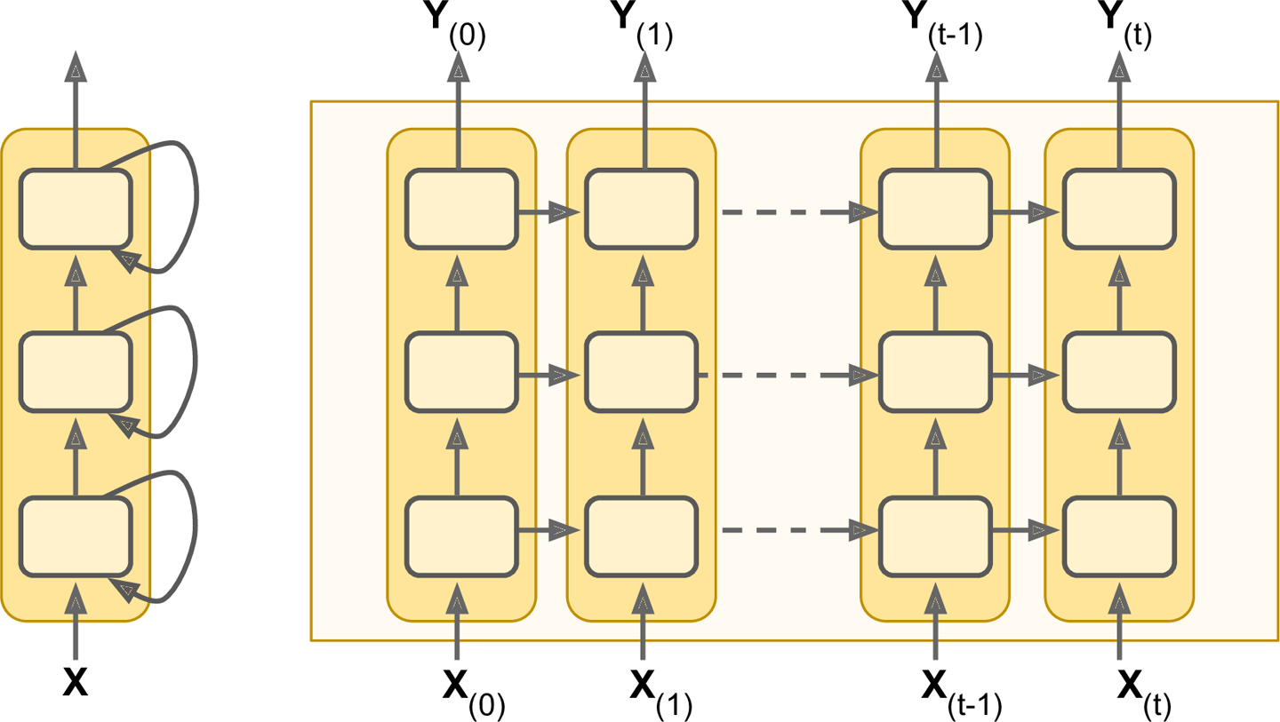
Deep RNN
It is quite common to stack multiple layers of cells.

Slide 35
The Difficulty of Training over Many Time Steps
Deep RNN may suffer from the vanishing/exploding gradients problem and take forever to train.
Good parameter initialization, nonsaturating activation functions (e.g., ReLU), Batch Normalization, Gradient Clipping, and faster optimizers.
The simplest and most common solution to this problem is to unroll the RNN only over a limited number of time steps during training. This is called truncated backpropagation through time.
Long term dependencies

Slide 36
Limitation of RNN
Recurrent Neural Networks work just fine when dealing with short-term dependencies.
The colour of milk is ---
Nothing to do with the context of the statement.
The RNN need not to remember what was said before this, or what was its meaning.
Vanilla RNNs fail to understand the context behind an input.
Something that was said long before, cannot be recalled when making predictions in the present.

Slide 37
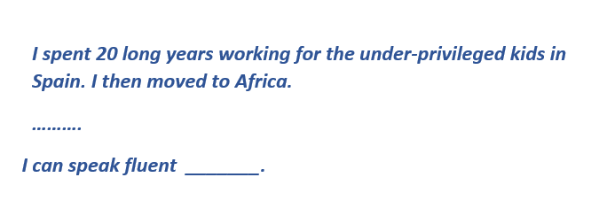
Problem of RNN
To make a proper prediction, the RNN needs to remember this context.
The relevant information may be separated from the point where it is needed, from the irrelevant data.
The reason behind this is the problem of Vanishing Gradient.

